Slide 1

Salt substitution and community-wide reductions in blood pressure and hypertension incidence
J. Jaime Miranda, MD, PhD
CRONICAS Centre of Excellence in Chronic Diseases
Universidad Peruana Cayetano Heredia
Lima, Peru
@jjaimemiranda | Jaime.Miranda@upch.pe

Slide 2






Conflicts of interests @jjaimemiranda
This study
Funded by NHLBI-NIH
Global Alliance for Chronic Diseases (GACD) programme
NCT01960972
Me
AHPSR/WHO, CONCYTEC, GCC, IDRC, MRC, NIH, SNF, Wellcome, WDF
No pharma funding
Notes:
NHLBI – UnitedHealth

Slide 3

Hypertension a global health issue
Individuals, households, communities and societies
Health systems
chronic care
human resources
task-shifting

Slide 4

Not enough cardiologists
Forecasting imbalances in the global health labor market and devising policy responses
The Supply and Demand of the Cardiovascular Workforce: Striking the Right Balance
Urgent need for human resources to promote global cardiovascular health
Trends and contexts in European cardiology practice for the next 15 years: the Madrid Declaration
Too many patients, too few cardiologists to care?
Hum Resour Health 2018;16(1):5. | J Am Coll Cardiol 2016;68(15):1680-1689. | Nat Rev Cardiol 2011;8(2):114-7. | Eur Heart J 2007;28(5):634-7. | Can J Cardiol 2006; 22(11): 901–902.

Slide 5
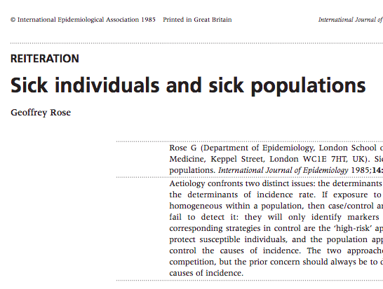
Geoffrey Rose, 1985
“The corresponding strategies in control are the ‘high-risk’ approach, which seeks to protect susceptible individuals, and the population approach, which seeks to control the causes of incidence […] not usually in competition, but the prior concern should always be to discover and control the causes of incidence.”
Rose G. Sick individuals and sick populations. Int J Epidemiol 1985; 14:32–38.

Slide 6
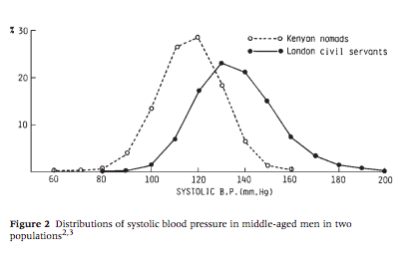
The most important public health question
“‘Why is hypertension absent in the Kenyans and common in London?’. The answer to that question has to do with the determinants of the population mean; for what distinguishes the two groups is nothing to do with the characteristics of individuals, it is rather a shift of the whole distribution —a mass influence acting on the population as a whole.”
Rose G. Sick individuals and sick populations. Int J Epidemiol 1985; 14:32–38.

Slide 7
Blood pressure matters
“Even a 2 mm Hg lower usual SBP would involve about 10% lower stroke mortality and about 7% lower mortality from IHD or other vascular causes in middle age.”
Prospective Studies Collaboration. Age-specific relevance of usual blood pressure to vascular mortality: a meta-analysis of individual data for one million adults in 61 prospective studies. Lancet 2002;360(9349):1903-13.

Slide 8
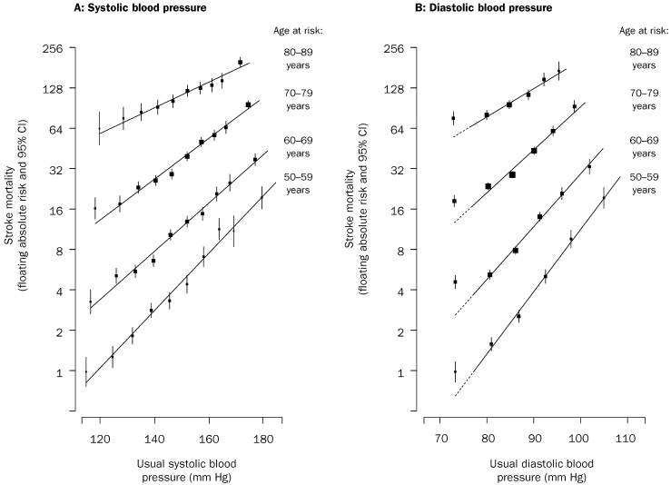
Prospective Studies Collaboration
“So, for the general normotensive population, producing persistent reductions in average blood pressure of just a few mm Hg by some widely practicable methods […] should avoid large absolute numbers of premature deaths and disabling strokes.”
Prospective Studies Collaboration. Age-specific relevance of usual blood pressure to vascular mortality: a meta-analysis of individual data for one million adults in 61 prospective studies. Lancet 2002;360(9349):1903-13.
Notes:
Mortality rate in each decade of age versus usual blood pressure at the start of that decade
“Among people with no previous vascular disease recorded, the usual blood pressure is positively related to the risks of death from vascular disease not only among individuals who might be considered hypertensive, but also among those who would usually be considered normotensive.”

Slide 9
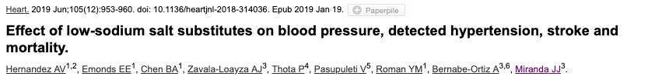
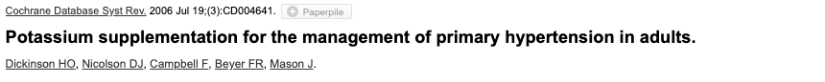
Salt and BP ↓sodium ↑potassium

Slide 10
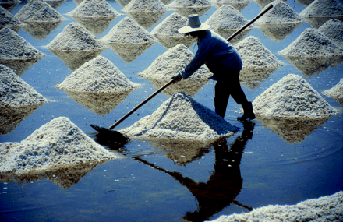
Telling people to reduce salt…
Aim: To assess the long term effects of advice to restrict dietary sodium in adults with and without hypertension.
Conclusion: Intensive interventions, unsuited to primary care or population prevention programmes, provide only small reductions in blood pressure and sodium excretion, and effects on deaths and cardiovascular events are unclear.
2014 Cochrane review update: conclusions unchanged
Hooper L, Bartlett C, Davey Smith G, Ebrahim S. Systematic review of long term effects of advice to reduce dietary salt in adults. BMJ 2002;325(7365):628.
Notes:
Hooper L, Bartlett C, Davey Smith G, Ebrahim S. Systematic review of long term effects of advice to reduce dietary salt in adults. BMJ 2002;325(7365):628.

Slide 11
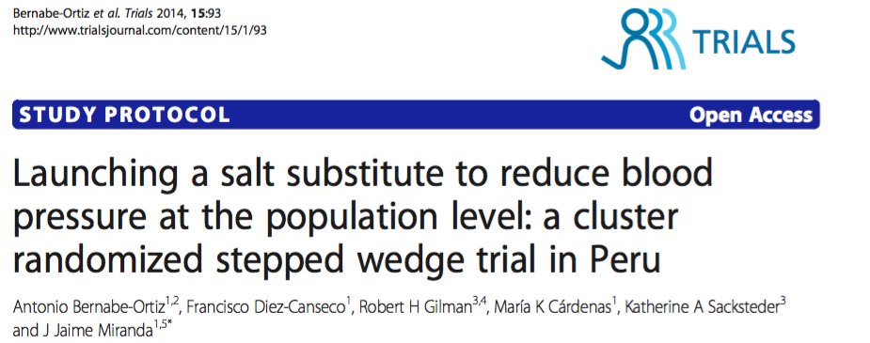
Study protocol: NCT01960972

Slide 12
Study objective and design
To assess the efficacy of a pragmatic intervention using a salt substitution strategy to reduce blood pressure, as well as its impact on the incidence of hypertension, at the population level using a stepped wedge cluster trial in Peru.

Slide 13
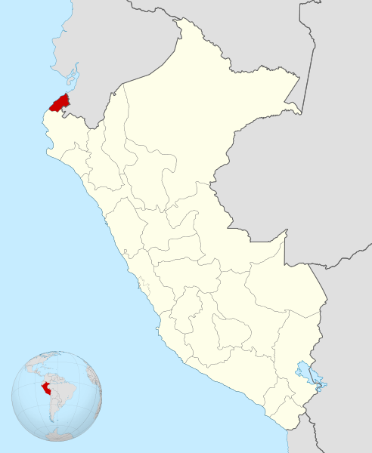
Tumbes, Peru
Department: Tumbes
Population: ~200,000
Poverty level: ~25.0%
Hypertension: 26.9% (≥35 y/o, in 2010)

Slide 14
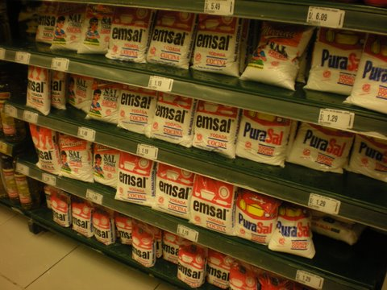
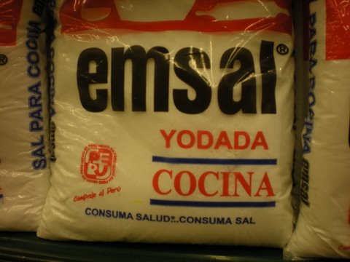
Regular salt, 100% NaCl
Notes:
Regular salt costs =

Slide 15
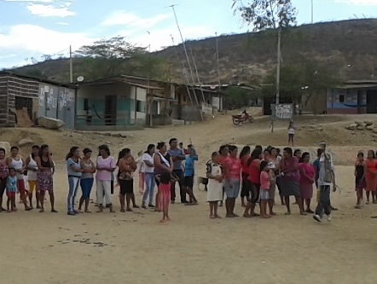
Participants
6 semi-rural villages
Agriculture or fishing
All adults ≥18yo
2376/2605 (91.2%) enrolled
Excluded
chronic kidney disease
heart disease, digoxin tx

Slide 16
Intervention
To guarantee the full replacement of salt in the entire village
What? Salt substitute
How? Free of charge but in exchange of regular salt (*)
Where? Families, small shops, bakeries and community kitchens, food vendors including street vendors and restaurants.
When? 2014-2017
(*) 1 Kg of regular salt ~US$ 0.20-0.30
Notes:
Regular salt ~US $0.30

Slide 17
Outcomes
Primary
Secondary
Systolic blood pressure (SBP)
Diastolic blood pressure (DBP)
BP measured every 5 months
7 rounds of measurements
Incidence of hypertension
SBP ≥140 mm Hg or DBP ≥90 mm Hg
Changes in levels of sodium and potassium excretion in 24-hour urine.
random sub-sample of participants
SBP and DBP
by HT status
by age groups

Slide 18


Slide 19
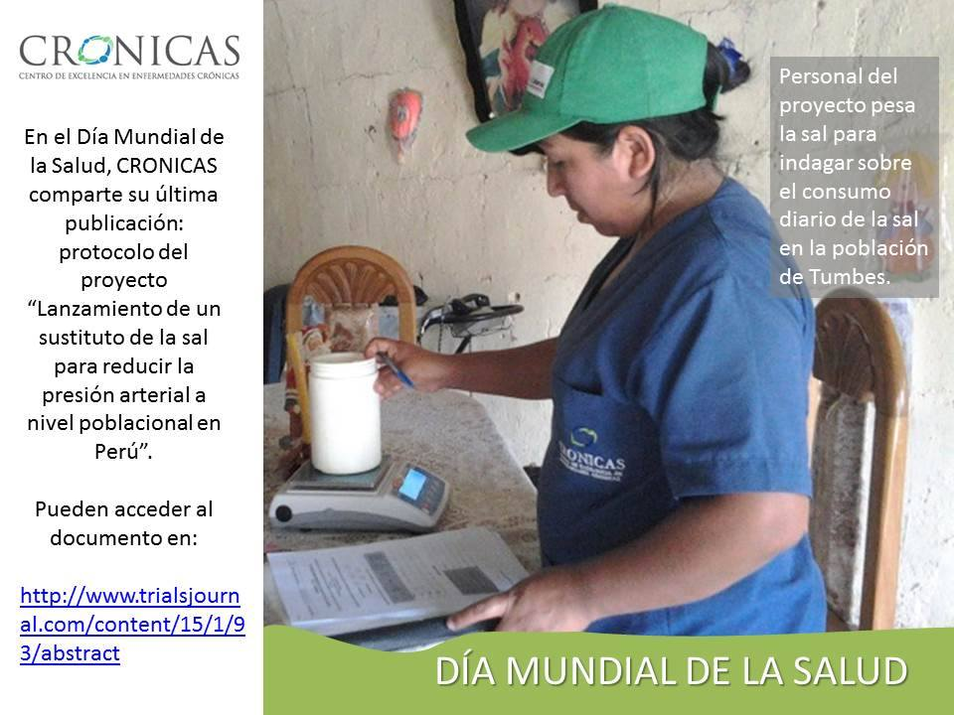
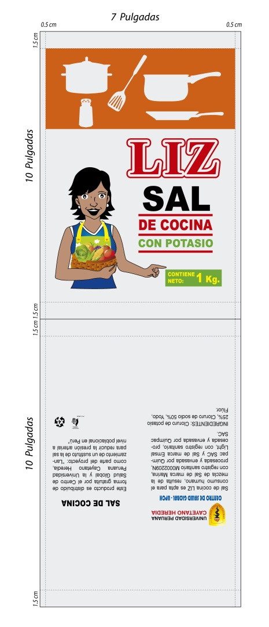
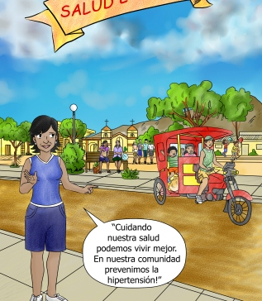
Formative Research
Identify optimal flavor
Triangle taste test
75% NaCl & 25% KCl
Identify target audience
Interviews + focus groups
Women & community
Develop product identity
Short questionnaire
60 participants, 10 per village

Slide 20
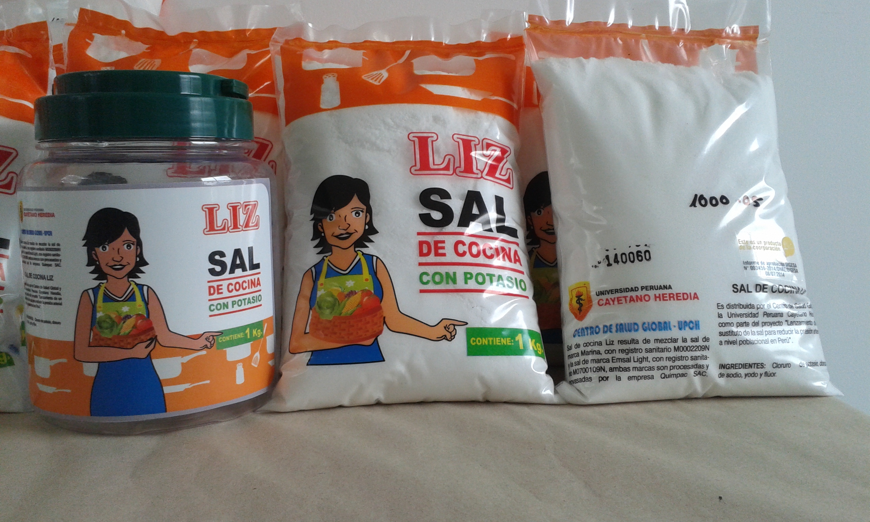
Product Identity
Name: Liz
Character: Local women
Packaging: Transparent plastic bags, red and orange colors, including product information, 1 Kg
Salt container: Plastic, screw cap, 1 Kg. capacity.

Slide 21
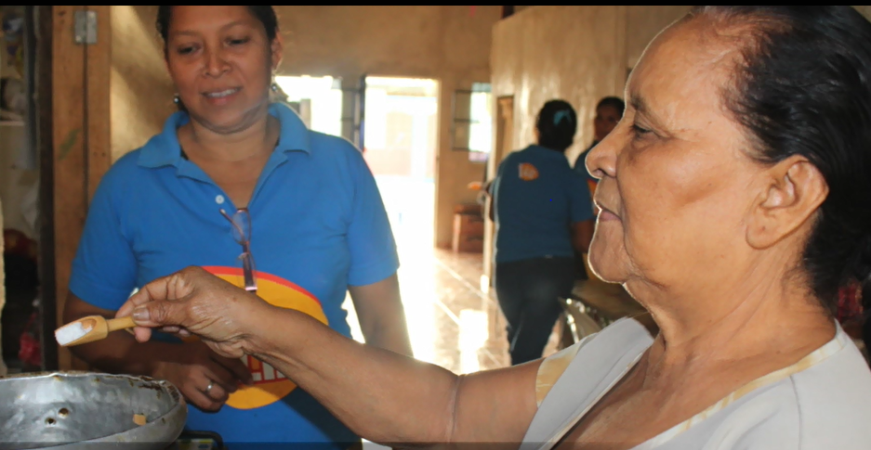
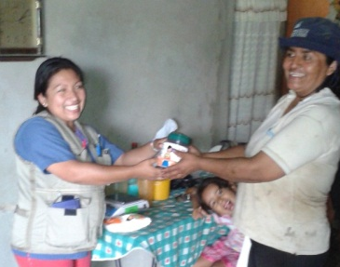
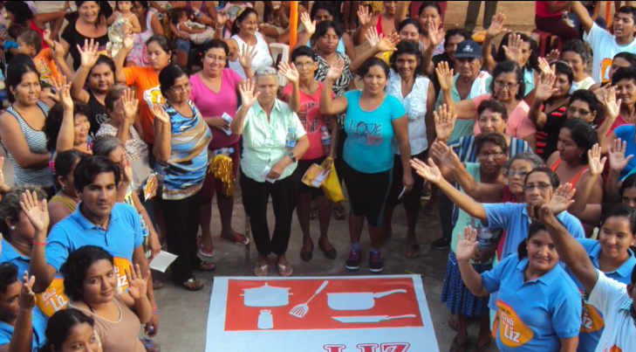
Social Marketing Campaign 4Ps
Product | Salt Liz
Price | Exchange
Place | Door-to-door + network
Promotion | Campaign

Slide 22


Slide 23
Table 1: Baseline characteristics

Slide 24
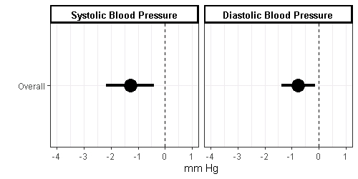
Overall reductions in SBP and DBP
SBP -1.23 mm Hg [95% CI -0.38; -2.07], p = 0.004
DBP -0.72 mm Hg [95% CI -0.10; -1.34], p = 0.022
Notes:
There was no evidence that the effect of the intervention was modified over time
(p = 0.14 for SBP, p = 0.46 for DBP).

Slide 25
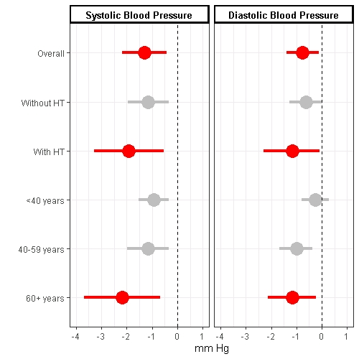
Reductions in SBP and DBP
People with hypertension
SBP -1.92 mm Hg [95% CI -3.29; -0.54]
Subjects ≥60 yo
SBP -2.17 mm Hg [95% CI -3.67; -0.68]
Notes:
Among people with hypertension
SBP -1.92 (-3.29; -0.54)
DBP -1.18 (-2.29; -0.08)
Among subjects ≥60 yo
SBP -2.17 (-3.67; -0.68)
DBP -1.18 (-2.14; -0.22)

Slide 26
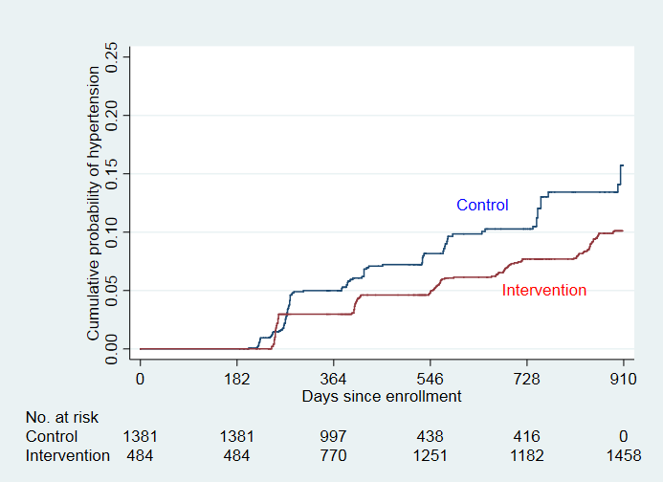
Cumulative probability of developing hypertension
Fully-adjusted model: HR 0.45 [95% CI 0.31 – 0.66], p<0.001
Notes:
Fully-adjusted model accounts for clustering at the village level plus adjustments by age, sex, education, wealth index, and body mass index
Crude cluster-only model (only accounts for clustering at the village level)
Adjusted by cluster-only: HR 0.49 [95% CI 0.34 – 0.71], p<0.001

Slide 27
24-hour urine samples
Random sub-sample of 600 participants
Sodium
Potassium
Baseline 3.94g ± SD 1.86
End 3.95g ± SD 1.83
p = 0.93
Baseline 1.97g ± SD 1.20
End 2.60g ± SD 1.20
p < 0.001

Slide 29
Pragmatic intervention

Slide 30
Blood pressure matters
“Even a 2 mm Hg lower usual SBP would involve about 10% lower stroke mortality and about 7% lower mortality from IHD or other vascular causes in middle age.”
Prospective Studies Collaboration. Age-specific relevance of usual blood pressure to vascular mortality: a meta-analysis of individual data for one million adults in 61 prospective studies. Lancet 2002;360(9349):1903-13.

Slide 31
Conclusions
Our project established an effective pragmatic population-wide salt substitute strategy
Reductions in the whole population’s blood pressure
Higher reductions in high-risk groups
Individuals with hypertension, ≥60 years old
55% reduction in hypertension incidence (HR 0.45)
Notes:
With HT 1.74 mm Hg (95% CI: 0.44; 3.04) and 1.25 mm Hg (95% CI: 0.27; 2.24) in DBP
≥60yo 1.95 mmHg (95%CI: 0.45; 3.44) in SBP and of 1.13 mmHg (95%CI: 0.18; 2.09)

Slide 32
Key messages
Hypertension rates and non-adherence to medication are global concerns, and non-pharmacological interventions at the population level to improve blood pressure control are required
Our social marketing intervention demonstrated population-wide benefits
Public health gains through shifting the population distribution
Clinical and health systems impacts by halving hypertension incidence
Switching to low-sodium high-potassium salts is feasible and it is effective in reducing blood pressure

Slide 33
The future
Salt substitutes into daily life
Adaptation → further changes in Na, K
Think about K, not only about Na
Potentially better results, considering that our study participants
Young → 27% were 18-29 years-old
Baseline BP levels → 113 mm Hg SBP

Slide 34


Generosity
Innovation
Integrity
Quality
www.cronicas-upch.pe

Slide 35

@jjaimemiranda Jaime.Miranda@upch.pe www.cronicas-upch.pe

Slide 36
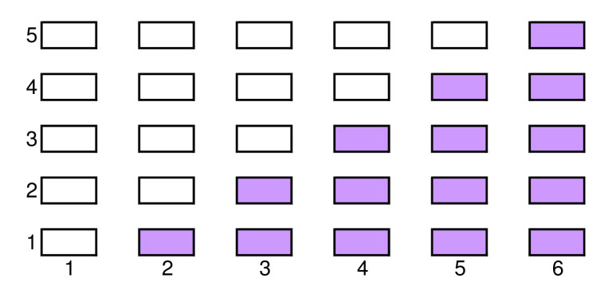
Design: stepped wedge trial
Villages (clusters)
Time (in periods)
Source: Brown CA, Lilford RJ. BMC Med Res Methodol 2006;6:54

Slide 37
Adverse events
None
Notes:
Based on reporting to the study team of any of the following: Malestar general, Nauseas, Fatiga muscular, Debilidad muscular, Adormecimiento en la piel, Palpitaciones, Incremento del número de respiraciones, Arritmias cardiacas

